Slide 1

Specialty Referral Tracking
Provider Training
2025

Slide 2
Specialty Referral Tracking Requirements
MCSHP Quality Management departments are under monthly audits to comply with the health plans. Surveilled for the function of referral tracking/missed appointments processes.
For compliance requirements to be met that evidence coordination of care between PCP and SCP, and reflect that there is responsible utilization management, it is necessary for PCP offices to be able to furnish the following when requested:
  Documentation on the patient's medical record that show results have been received from the specialist that PCP referred patient to.
  Evidence on medical record that there was follow up if the referral went unused.
Example 1: "Office staff called patient to inquire about why the referral was not utilized. Left message on patient’s voicemail."
Example 2: "Office staff called specialist office to request notes from patient visit. Staff member indicated that patient never made an appointment / missed appointment on MM/DD/YYYY"

Slide 3

Specialty Referral Bi-Monthly Distribution Schedule

Slide 4

How we meet and support compliance…
What to do:
    Use MCSHP Specialty Referral Tracking list provided on a Bi-Monthly basis
    Review list of Medi-Cal members used specialty referrals on a Bi-Monthly basis
    Keep a log to track and follow-up on missing chart notes documentation
    Check in the member’s outpatient chart/EHR if there is evidence that the consulting physician sent a letter, written report or discussed member's results with the referring physician. If results were communicated verbally in person or telephonically, evidence of PCP documentation of discussion should be in members medical records.

Slide 5
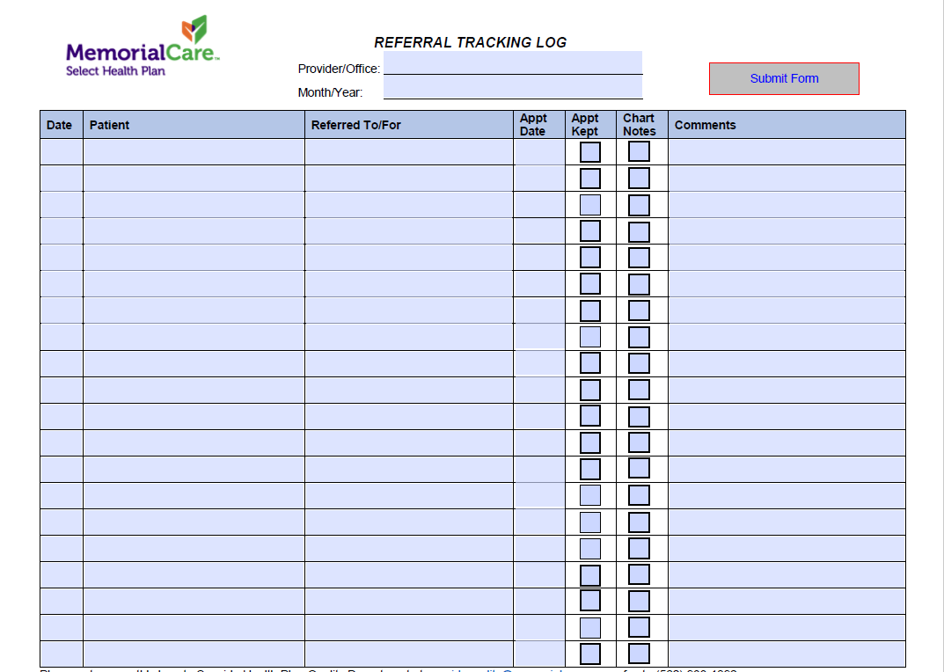
Example: of Referral Tracking Log for Used Specialty Referrals or Unused Authorization Referrals
Use tool to track outreach efforts
Upload consult notes from Specialist to member’s medical record

Slide 6
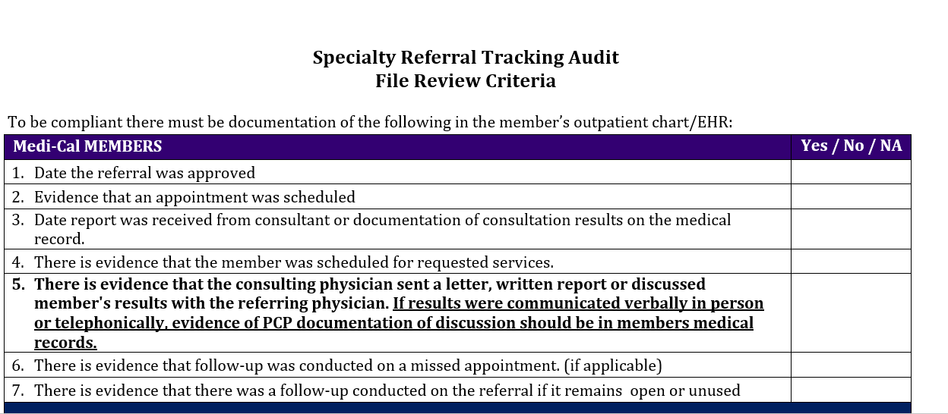
MCSHP Quarterly File Audit Documentation Criteria
*tool used for Internal Audit

Slide 7
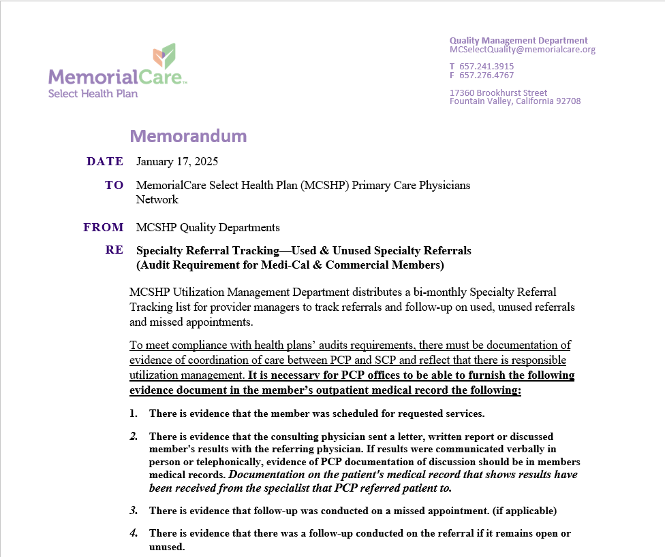
Submit signed attestation to Quality Department
Attestation document will be attached to email
Action Required:
Remember to sign the attestation and
Email it to MCSelectQuality@memorialcare.org
by February 07,2025.

Slide 8
Questions?
Contact:
MemorialCare Select Health Plan
Syntyche Jenkins
Quality Coordinator
Office: (657)241-3915
Email: sjenkins3@memorialcare.org
Department Email:
MCSelectQuality@memorialcare.org

Slide 9
Thank you.

