Slide 1
REPORTING REQUIREMENTS
RELATED TO
PROVIDER PREVENTABLE CONDITIONS
DHCS All Plan Letter 17-009 Duals Plan Letter 17-002
Presented by:
Enterprise Performance Optimization Department
Rev. 02/2023
LA5007 0223
Notes:
JC

Slide 2

ACRONYMS and TERMS
APL | All Plan Letter: the means by which the DHCS Medi-Cal Managed Care Division conveys information or interpretation of changes in policy or procedure at the Federal or State levels, and provides instruction to contractors, if applicable on how to implement these changes on an operational basis.
BENEFICIARY | Member
DHCS | Department of Health Care Services
MCP; MMP | Managed Care Plan; Medi-Medi Plan
7107 (superseded by online) | The prior form required for submission by MCPs and delegates when a Provider Preventable Reportable Condition occurs is now replaced by online-only reporting.
Delegate | A contracted provider that has delegated responsibility to provide services for Medi-Cal beneficiaries
DPL | Duals Plan Letter (see APL) Duals Plan Letters apply to managed Dual covered members. Note: CMC = D-SNP as of 01/01/23
PPC/PPRC | Provider preventable conditions/provider preventable reportable conditions – Please see presentation for examples.
"Invasive procedure" | Refers to a surgical procedure
APL 17-009/Provider Preventable Conditions Reporting
2
Notes:
JC

Slide 3


What will this presentation cover?
Part I of this presentation will cover the fundamental principles of the Provider Preventable Conditions (PPC) requirements
Part II of this presentation will detail the process for completing the online reporting form as required by the state
Part III describes LA Care’s new annual PPC Reporting Attestation process including catch-up attestations for the years 2021 & 2022 and January, 2023, due to your LA Care ACM by March 13, 2023.
APL 17-009/Provider Preventable Conditions Reporting
3
Notes:
JC

Slide 4

Part I Fundamentals of PPCs
APL 17-009/Provider Preventable Conditions Reporting
4
Notes:
JC

Slide 5
What is All Plan Letter 17-009 and
Dual Plan Letter 17-002?
All Plan Letter (APL) 17-009 and Dual Plan Letter (DPL) 17-002 were released to inform all Medi-Cal managed care health plans (MCPs) and delegates of updated reporting requirements for encounter data resulting from provider preventable conditions (PPCs).
APL 17-009/Provider Preventable Conditions Reporting
5
Notes:
HR

Slide 6
What is a PPC?
There are two types of PPCs:
Health Care Acquired Conditions (HCAC), which should be reported if these occur in an inpatient acute care hospital
Other Provider-Preventable Conditions (OPPC), which should be reported if these occur in any health care setting
APL 17-009/Provider Preventable Conditions Reporting
6
Notes:
JC

Slide 7
How are Provider Preventable Conditions treated under the law?
Title 42 of the Code of Federal Regulations (CFR) Sections 438.3(g), 434.6(a)(12)(i), and 447.26 and Welfare and Institutions Code Section 14131.11 prohibit the payment of Medicaid/Medi-Cal funds to a provider for the treatment of a PPC, except when the PPC existed prior to the initiation of treatment for that beneficiary by that provider.
APL 17-009/Provider Preventable Conditions Reporting
7
Notes:
HR

Slide 8
Who is required to report and when?
Reporting is required for all Medicare and
Medi-Cal lines of business.
Providers are required to report to both the Managed Care Plan (L.A. Care) and to the state via the online reporting form.
Plan Partners and Provider Groups are required by DHCS to monitor claims and encounter data; if a PPC is noted, the Plan Partner or Provider Group is required to utilize the online reporting form and a copy must be sent to L.A. Care.
APL 17-009/Provider Preventable Conditions Reporting
8
Notes:
JC

Slide 9
What is L.A. Care’s Responsibility?
L.A. Care will also continue to monitor claims and encounter data internally. If a possible PPC is noted L.A. Care will request records from delegates for validation.
If a PPC is evidenced, L.A. Care will complete the online reporting form and notify the Plan Partner or Provider Group that this has been completed.
APL 17-009/Provider Preventable Conditions Reporting
9
Notes:
HR

Slide 10
What else is L.A. Care’s Responsibility?
L.A. Care maintains a designated staff person to accept PPC reporting and maintains copies of all reporting.
APL 17-009/Provider Preventable Conditions Reporting
10
Notes:
HR

Slide 11
What are Requirements for Monitoring for PPCs?
Encounter and claims data must be monitored for incidents of PPCs using the diagnosis identified by CMS as HCAC or OPC/OPPC, encompassing (at minimum) all of the conditions and events that are noted at the end of this presentation.
PPCs may also come from Quality reviews via Potential Quality Indicators (PQIs) or Appeals and Grievances and it is important that your organization understands the need to be aware of potential PPCs.
APL 17-009/Provider Preventable Conditions Reporting
11
Notes:
HR

Slide 12
Identifying Reportable Conditions
To repeat, a PPC or PPRC is defined by DHCS as one of two types:
Health Care Acquired Conditions (HCAC), which should be reported if these occur in an inpatient acute care hospital.
Other Provider Preventable Conditions (OPPC), which should be reported if these occur in any health care setting.
See the following slides for more details.
APL 17-009/Provider Preventable Conditions Reporting
12
Notes:
HR

Slide 13
Identifying Reportable Conditions cont.
Identifying the “at minimum” conditions (see links at end of presentation) via claims and encounter data may result in the need for data validation and reporting if it is found that a possible PPC exists.
NOTE:
Reporting PPCs for Medi-Cal or D-SNP beneficiaries to DHCS does not remove the reporting requirement for adverse events and healthcare-associated infections (HAI) to the California Department of Public Health, pursuant to Health and Safety Code sections 1279.1 and 1288.55.
Providers do not need to report PPCs that existed prior to the initiation of treatment of the beneficiary by the provider.
APL 17-009/Provider Preventable Conditions Reporting
13
Notes:
HR

Slide 14
What are HCACs?
HCACs are the same conditions as the Hospital Acquired Conditions (HACs) that are reportable for Medicare, with the exception that Medi-Cal does not require providers to report deep vein thrombosis/pulmonary embolism for pregnant women and children under 21 years of age, as noted below. The ICD-10-CM codes for HCACs are available on the CMS website.
-see link at end of presentation
APL 17-009/Provider Preventable Conditions Reporting
14
Notes:
JC
HCAC = HEALTH CARE REQUIRED CONDITIONS

Slide 15
What are HCACs?
Providers need to report HCACs only when they occur in inpatient acute care hospitals.
HCACs:
Air embolism
Blood incompatibility
Catheter-associated urinary tract infection
Deep vein thrombosis/pulmonary embolism (excluding pregnant women and children under 21 years of age)
APL 17-009/Provider Preventable Conditions Reporting
15
Notes:
JC

Slide 16

What are HCACs?
cont.
Providers need to report HCACs only when they occur in inpatient acute care hospitals.
HCACs:
Falls/trauma that result in the following:
Fracture
Dislocation
Intracranial injury
Crushing injury
Burn
Electric shock
Foreign object retained after surgery
Iatrogenic pneumothorax with venous catheterization
APL 17-009/Provider Preventable Conditions Reporting
16
Notes:
JC

Slide 17
HCACs cont.
Surgical site infections following:
Bariatric surgery
Laparoscopic gastric bypass
Gastroenterostomy
Laparoscopic gastric restriction surgery
Orthopedic procedures for spine, neck, shoulder, and elbow
Cardiac implantable electronic device (CIED) procedures
Vascular catheter-associated infection
APL 17-009/Provider Preventable Conditions Reporting
17
Notes:
JC

Slide 18
HCACs cont.
Manifestations of poor glycemic control
Diabetic ketoacidosis
Nonketotic hyperosmolar coma
Hypoglycemic coma
Secondary diabetes with ketoacidosis
Secondary diabetes with hyperosmolarity
Stage III or IV pressure ulcers
Surgical site infection
Mediastinitis following coronary artery bypass graft (CABG)
APL 17-009/Provider Preventable Conditions Reporting
18
Notes:
JC

Slide 19
What are OPPCs?
OPPCs (or Other Provider Preventable Conditions) are also known as "never events" and Serious Reportable Events under Medicare. For Medi-Cal, OPPCs are defined as follows:
Wrong surgery/invasive procedure
Surgery/invasive procedure performed on the wrong patient
Surgery/invasive procedure performed on the wrong body part
>Providers must report these three OPPCs when these occur in any health care setting.
APL 17-009/Provider Preventable Conditions Reporting
19
Notes:
JC

Slide 20
Part II PPC Reporting Process
APL 17-009/Provider Preventable Conditions Reporting
20
Notes:
HR

Slide 21
How are PPC/PPRCs Reported?
The process begins with identifying possible PPRCs. Once a PPRC is identified the records should be requested for validation.
The member’s Medi-Cal or dual eligible status should be verified and the Claims Unit/Department should be notified so that payments related to the identified condition or incident for the potential PPC facility/provider can be held.
APL 17-009/Provider Preventable Conditions Reporting
21
Notes:
HR

Slide 22
How are PPC/PPRCs Reported?
cont.
If the member is a Medi-Cal/Dual Eligible member and records show a PPC, the following steps should be completed in the order shown.
Next Slide
APL 17-009/Provider Preventable Conditions Reporting
22
Notes:
HR

Slide 23
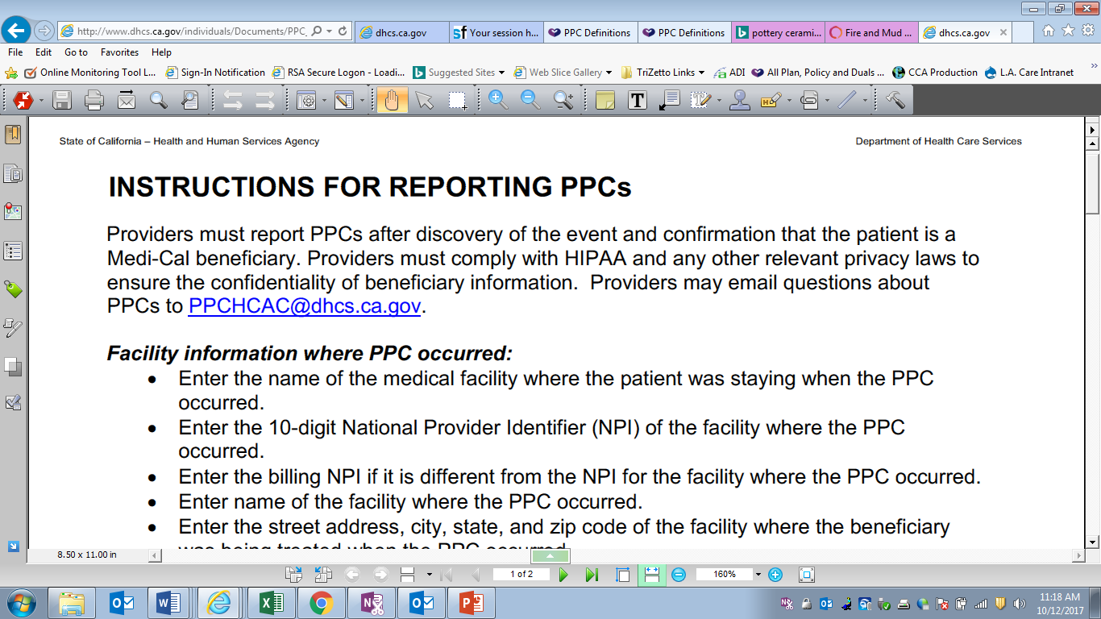
Step 1:
Review directions for online portal
Instructions for the online portal are located here:
http://www.dhcs.ca.gov/individuals/Pages/PPC_Form_Instructions.aspx
APL 17-009/Provider Preventable Conditions Reporting
23
Notes:
HR

Slide 24
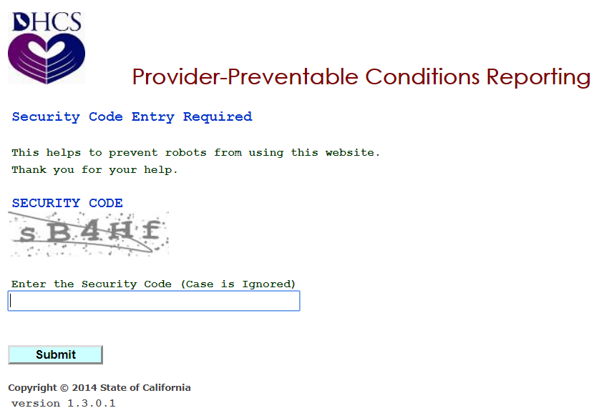
Step 2:
Complete form online and submit in online portal
The DHCS online portal can be accessed here:
https://apps.dhcs.ca.gov/PPC/SecurityCode.aspx
APL 17-009/Provider Preventable Conditions Reporting
24
Notes:
HR

Slide 25
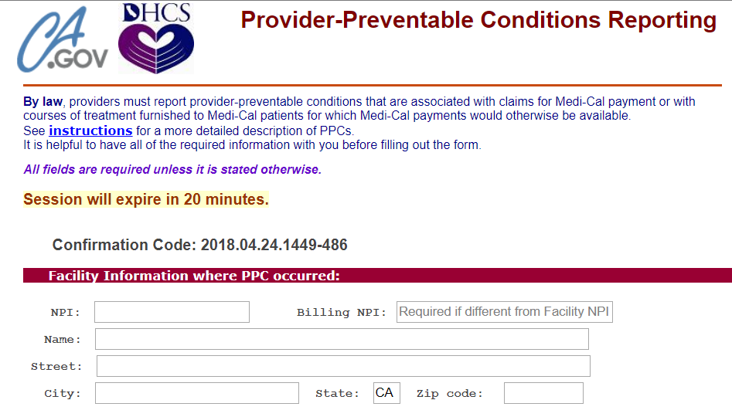
Step 3:
Complete online form and submit in online portal ensuring a copy is kept for submission to L.A. Care
The online portal can be accessed here:
https://apps.dhcs.ca.gov/PPC/SecurityCode.aspx
APL 17-009/Provider Preventable Conditions Reporting
25
Notes:
HR

Slide 26
Step 4: Send a copy to L.A. Care
Please submit a copy of the form to your L.A. Care ACM (Account Communications Manager) via the Delegation Oversight (DO) SFTP Site folder.
Provide a screen shot of your upload to the EPOCommunications email: <EPOCommunications@lacare.org>
APL 17-009/Provider Preventable Conditions Reporting
26
Notes:
HR

Slide 27
Part III New: Delegate PPC Reporting Attestations
APL 17-009/Provider Preventable Conditions Reporting
27
Notes:
HR

Slide 28
2021-2022 Delegate PPC Attestations
Due to lack of reporting submissions of PPCs from delegates to LA Care, you will be required to attest that your organization has had no PPCs.
The attestation sent with this presentation is due to your ACM at the EPOCommunications email: EPOCommunications@lacare.org by March 13, 2023.
Delegates must either submit the attestation or provide copies of all PPCs for years 2021-2022 and January, 2023 by March 13, 2023.
LA Care will continue the attestations process annually.
APL 17-009/Provider Preventable Conditions Reporting
28
Notes:
HR

Slide 29

References/Links
APL 17-009 (Medi-Cal)
https://www.dhcs.ca.gov/formsandpubs/Pages/AllPlanLetters.aspx
DPL 17-002 (Dual Eligible)
https://www.dhcs.ca.gov/formsandpubs/Pages/MgdCareDualsPlanLetters.aspx
CMS listing for Medicare: HACs
https://www.cms.gov/medicare/medicare-fee-for-service-payment/hospitalacqcond/hospital-acquired_conditions.html
Latest CMS ICD 10 code lists for HACs
https://www.cms.gov/Medicare/Medicare-Fee-for-Service-Payment/HospitalAcqCond/icd10_hacs.html
(FY 2023 v40 ICD-10 Hospital Acquired Condition (HAC) List is also located under the Downloads section at the above link.)
FAQs related to PPCs
http://www.dhcs.ca.gov/individuals/Pages/AI_PPC.aspx
APL 17-009/Provider Preventable Conditions Reporting
29
Notes:
JC

Slide 30
Questions
Please reach out to your
assigned ACM
with any questions.
EPOCommunications@lacare.org
APL 17-009/Provider Preventable Conditions Reporting
30
Notes:
VB

Slide 31

From all of us at
Notes:
VB

