Slide 1


2026 Annual Specialty Referral Training
This Photo by Unknown Author is licensed under CC BY-SA-NC

Slide 2
Introduction to Specialty Referral Training
Notes:
--- This slide references information from the following file: https://memorialcare-my.sharepoint.com/personal/sjenkins3_memorialcare_org/_layouts/15/Doc.aspx?sourcedoc=%7B96BC35C3-B017-496C-AD40-729FDB6DAD57%7D&file=IHA%20Case%20File%20Content%20List%2006252025.docx&action=default&mobileredirect=true Training Objectives

Slide 3

Training Objectives
Overview of Referral Process​
Understand the specialty referral process and its role in ensuring coordinated patient care.​
Regulatory Compliance​
Learn about regulatory requirements and standards that govern specialty referrals to maintain compliance.​
Audit Requirements​
Review audit components including universe submission, file selection, and proper documentation practices.​
Preventing Common Errors​
Identify frequent errors in referrals and explore strategies to avoid these mistakes.​
Provider Responsibilities​
Highlight best practices and responsibilities for providers to ensure timely and accurate referrals.​
Resources and Attestation​
Offer resources and instructions for attestation to fulfill compliance obligations effectively.

Slide 4
Specialty Referral Process and Compliance
Notes:
--- This slide references information from the following file: https://memorialcare-my.sharepoint.com/personal/sjenkins3_memorialcare_org/_layouts/15/Doc.aspx?sourcedoc=%7B96BC35C3-B017-496C-AD40-729FDB6DAD57%7D&file=IHA%20Case%20File%20Content%20List%2006252025.docx&action=default&mobileredirect=true Training Objectives

Slide 5
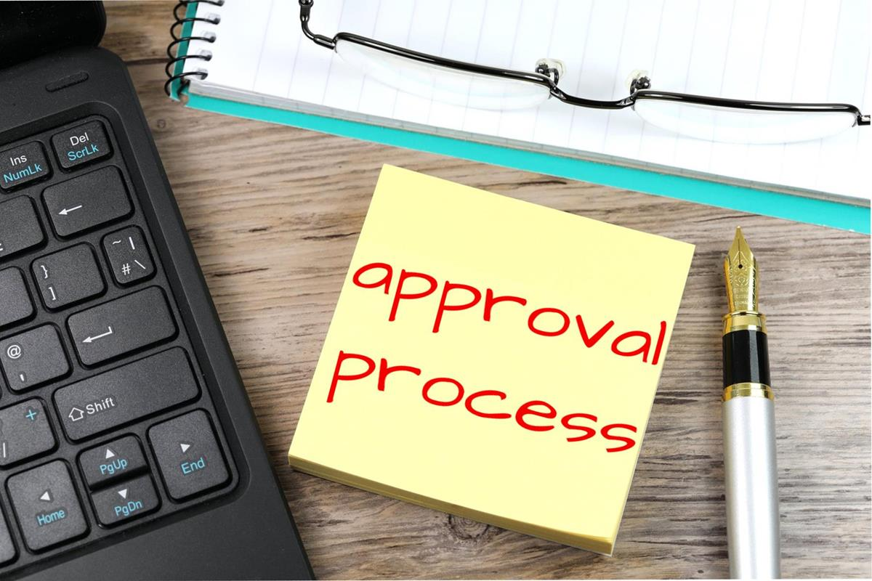
Overview of Specialty Referral Process
Initiating Referral​
Primary care providers identify patient needs requiring specialist consultation and submit referral requests accordingly.​
Referral Approval​
Referral requests often require prior authorization based on health plans and lines of business before scheduling specialist visits.​
Specialist Appointment​
Upon approval, patients schedule appointments with specialists to receive targeted care based on referral recommendations.​
Communication and Documentation​
Effective communication between specialists and PCPs, including sharing notes and follow-ups, ensures continuity and compliance.

Slide 6
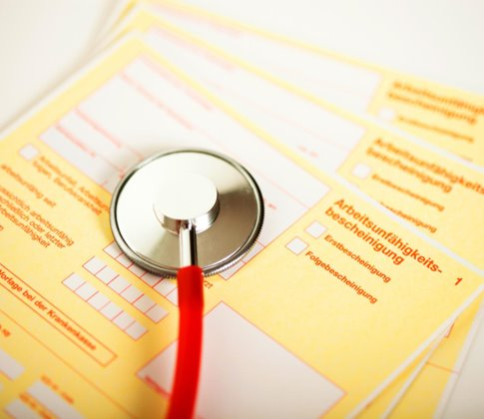
Overview of Specialty Referral Process (cont.)
Record Keeping & Documentation​
Regulatory bodies require accurate records of specialty referrals and documentation of all provider communications.​
Compliance with Authorization and Coding​
Prior authorization and adherence to CPT coding standards are essential compliance requirements in healthcare.​
Consequences of Non-Compliance​
Failure to comply can lead to audits, penalties, and compromised patient care quality.​
Integration into Workflows​
Providers must integrate regulatory requirements into daily workflows to ensure quality care and compliance.

Slide 7
Specialty Referrals Documentation requirements
Notes:
--- This slide references information from the following file: https://memorialcare-my.sharepoint.com/personal/sjenkins3_memorialcare_org/_layouts/15/Doc.aspx?sourcedoc=%7B96BC35C3-B017-496C-AD40-729FDB6DAD57%7D&file=IHA%20Case%20File%20Content%20List%2006252025.docx&action=default&mobileredirect=true Training Objectives

Slide 8

Required Documentation for Audit
Referral Authorization Copy​
A copy of the approved referral authorization must be included in each specialty referral file to validate the referral process.​
Consultation Note Sharing​
Evidence that the specialist’s consultation note was sent to the primary care provider ensures communication between providers.​
Follow-up Documentation​
Documentation of follow-up for missed appointments or unused referrals ensures patient care continuity and audit compliance.

Slide 9
Best Practices and Common Pitfalls
Notes:
--- This slide references information from the following file: https://memorialcare-my.sharepoint.com/personal/sjenkins3_memorialcare_org/_layouts/15/Doc.aspx?sourcedoc=%7B96BC35C3-B017-496C-AD40-729FDB6DAD57%7D&file=IHA%20Case%20File%20Content%20List%2006252025.docx&action=default&mobileredirect=true Training Objectives

Slide 10
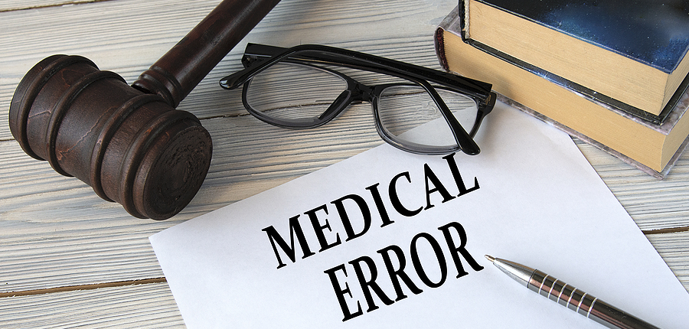
Common Errors & How to Avoid Them
Common Referral Errors​
Incomplete documentation, delays in consultation notes, and failure to follow up impact patient care negatively.​
Standardized Workflows​
Implementing standardized workflows improves referral tracking and reduces errors effectively.​
Electronic Health Alerts​
Using EHR alerts helps providers track pending documentation and ensures timely follow-up.​
Communication & Training​
Clear communication and regular staff training reduce non-compliance and improve patient care.

Slide 11

Common Errors & How to Avoid Them
Referral Initiation and Authorization​
Providers must initiate referrals based on clinical necessity and submit authorizations promptly to ensure timely care.​
Patient Eligibility Verification​
Verifying patient eligibility is essential to avoid delays and ensure smooth referral processing and approvals.​
Documentation and Communication​
Documenting communications and confirming receipt of consultation notes ensures coordinated and compliant patient care.​
Patient Education and Scheduling Support​
Educating patients about the referral process and assisting with scheduling enhances patient satisfaction and outcomes.

Slide 12
Resources and Attestation
Notes:
--- This slide references information from the following file: https://memorialcare-my.sharepoint.com/personal/sjenkins3_memorialcare_org/_layouts/15/Doc.aspx?sourcedoc=%7B96BC35C3-B017-496C-AD40-729FDB6DAD57%7D&file=IHA%20Case%20File%20Content%20List%2006252025.docx&action=default&mobileredirect=true Training Objectives

Slide 13
Common Errors & How to Avoid Them
Referral Initiation and Authorization​
Providers must initiate referrals based on clinical necessity and submit authorizations promptly to ensure timely care.​
Patient Eligibility Verification​
Verifying patient eligibility is essential to avoid delays and ensure smooth referral processing and approvals.​
Documentation and Communication​
Documenting communications and confirming receipt of consultation notes ensures coordinated and compliant patient care.​
Patient Education and Scheduling Support​
Educating patients about the referral process and assisting with scheduling enhances patient satisfaction and outcomes.

Slide 14
Resources & Attestation Instructions
Available Compliance Resources
MemorialCare offers referral templates, audit checklists, and regulatory guidelines to support provider compliance efforts.
Regular Review and Integration
Providers are encouraged to regularly review and integrate these resources into their daily workflows for consistent compliance.
Attestation Requirement
Training completion includes attestation to confirm understanding of referrals, audits, and compliance obligations for accountability.

Slide 15
Distribution of specialty referral reports

Slide 16
thanks

