Slide 1
MCSHP
Access to Care In-Service (2025)
Notes:
Good morning/afternoon
Welcome to MCSHP COZEVA Training
We have reviewed the Pre-Training Survey
This training will be interactive and we will take a break for those that need to stretch and/or go to the restroom.

Slide 2

Training Objectives
Understand appointment availability standards
Learn after-hours communication requirements
Recognize the importance of timely rescheduling
Improve survey response compliance
MCSHP Access To Care In-Service (2025)
Notes:
These are the key objectives of the training. We aim to improve understanding of access standards and ensure compliance through better communication and documentation.

Slide 3

Appointment Availability Standards
Urgent Care: Within 48 hours (PCPs), 96 hours (SCPs)
Routine Appointments: Within 15 business days
Initial Prenatal Visit: Within 10 business days
MCSHP Access To Care In-Service (2025)
Notes:
This slide outlines the required timeframes for different types of appointments. Emphasize the importance of meeting these standards to avoid non-compliance.

Slide 4

After-Hours Requirements
Answering service or recording must provide contact method
      On Call Provider
      Advise Nurse
Must state provider will return call within 30 minutes
MCSHP Access To Care In-Service (2025)
Notes:
After-hours communication is critical. Providers must ensure their voicemail or answering service includes a way to reach them and a 30-minute callback commitment.

Slide 5
Timely Rescheduling
Next Steps
Missed Appointment
Call
Document
Missed appointments must be rescheduled within 48 hours
Document all attempts to contact the patient medical record and send letter
MCSHP Access To Care In-Service (2025)
Notes:
Missed appointments must be followed up within 48 hours. Document all contact attempts to show compliance.

Slide 6

Annual Survey Participation
Mandatory Response to Annual Appointment Availability Surveys conducted health plan affiliates
Non-response affects compliance scores
MCSHP Access To Care In-Service (2025)
Notes:
Participation in appointment availability surveys is mandatory. Non-response negatively impacts compliance scores.

Slide 7
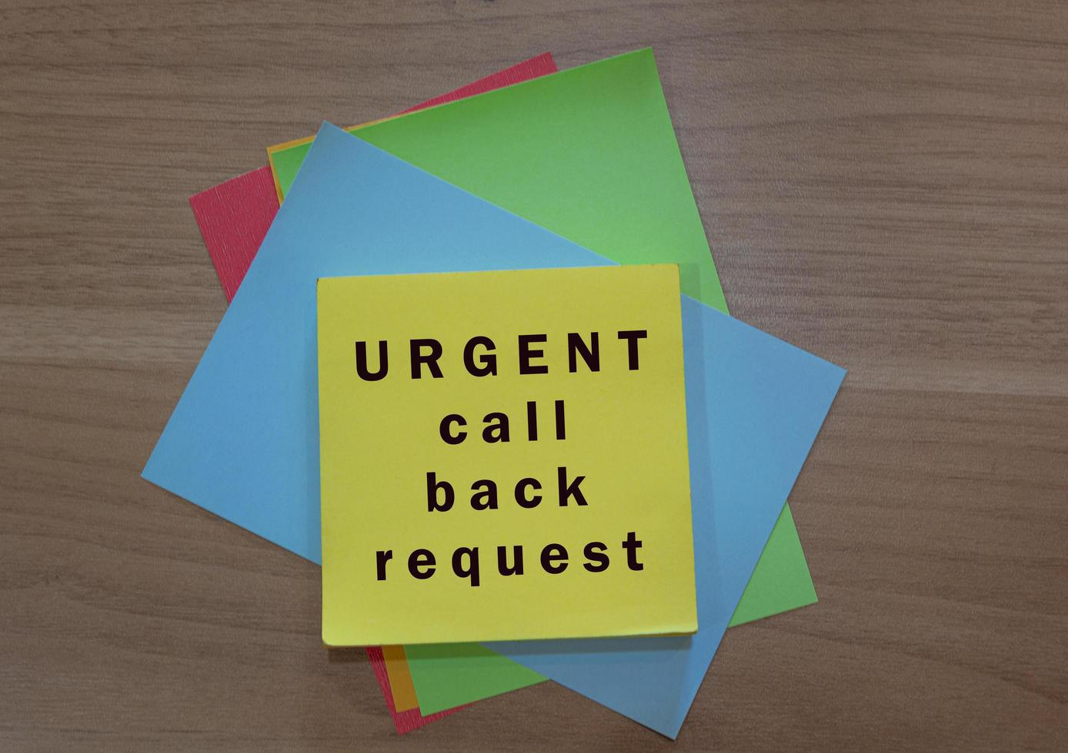
Scenario: Missed Call-Back
A patient calls at 4:30 PM with urgent symptoms. The provider returns the call at 6:00 PM.
→ This is non-compliant. Call-backs must occur within 30 minutes.
MCSHP Access To Care In-Service (2025)
Notes:
This scenario illustrates a non-compliant callback. Use it to reinforce the 30-minute rule for urgent calls during business hours.

Slide 8

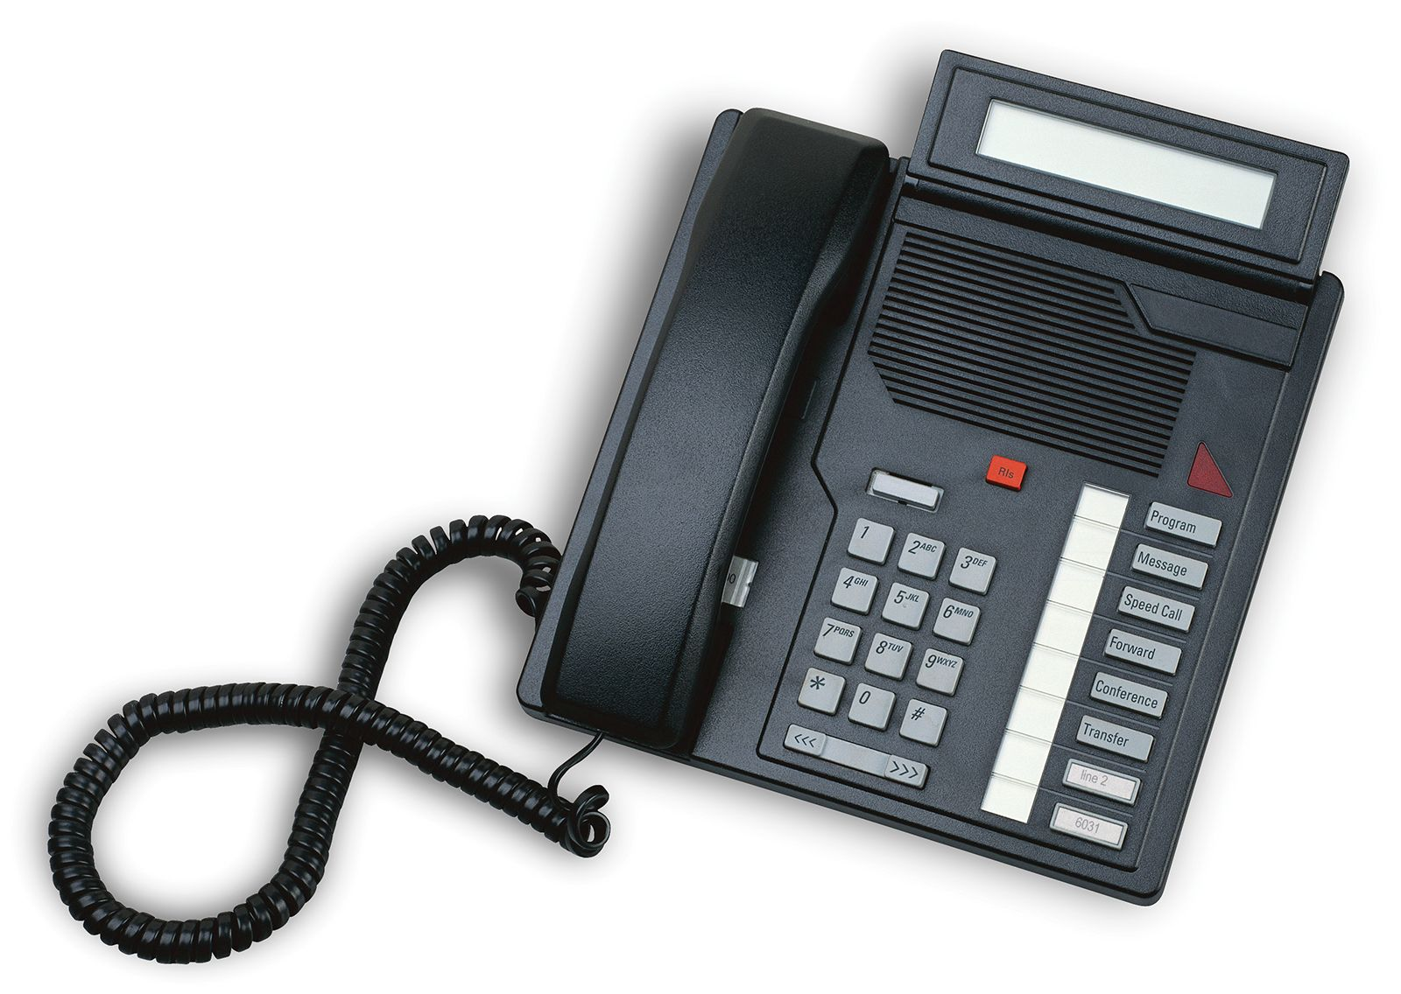
Scenario: After-Hours Message / Answering Service
A provider’s voicemail says the office is closed and does not provide emergency contact info.
→ This is non-compliant. Voicemail must include instructions to reach the provider.
MCSHP Access To Care In-Service (2025)
Notes:
This scenario shows a non-compliant voicemail. Providers must update their messages to include emergency contact instructions.

Slide 9

It’s QUIZ Time. Please click the image to access actual MCSHP Access To Care In-Service Quiz
Question 1
What is the required time frame for a provider to return an urgent call during business hours?
A. 1 hour
B. 30 minutes
C. 2 hours
D. 15 minutes
MCSHP Access To Care In-Service (2025)
Notes:
This is the first quiz question.

Slide 10
Quiz Question 2
How soon must a missed appointment be rescheduled?
A. 24 hours
B. 72 hours
C. 48 hours
D. 1 week
MCSHP Access To Care In-Service (2025)
Notes:
This is the second quiz question.

Slide 11
Quiz Question 3
What must an after-hours voicemail include to be compliant?
A. Office hours only
B. A callback number and 30-minute callback statement
C. A message to call 911
D. A list of services
MCSHP Access To Care In-Service (2025)
Notes:
This is the third quiz question.

Slide 12
Quiz Question 4
What is the maximum time allowed for a patient to wait in the office before being seen?
A. 15 minutes
B. 45 minutes
C. 30 minutes
D. 60 minutes
MCSHP Access To Care In-Service (2025)
Notes:
This is the fourth quiz question.

Slide 13
Quiz Question 5
What is the required response time for urgent appointment availability for Specialty Care Providers?
A. 24 hours
B. 72 hours
C. 48 hours
D. 96 hours
MCSHP Access To Care In-Service (2025)
Notes:
This is the fifth quiz question.

Slide 14
Quiz Question 6
Why is responding to the Appointment Availability Survey important?
A. It helps schedule vacations
B. It affects compliance scores
C. It is optional
D. It is used for marketing
MCSHP Access To Care In-Service (2025)
Notes:
This is the sixth quiz question.

Slide 15
Quiz Question 7
What is the standard for rescheduling a missed appointment?
A. Within 24 hours
B. Within 48 hours
C. Within 72 hours
D. Within 1 week
MCSHP Access To Care In-Service (2025)
Notes:
This is the seventh and final quiz question.

Slide 16
Thank You
Questions:
      Quality Improvement Department
              MCSelectQuality@memorialcare.org
              Team Members:
              Raashi Subramanya, Manager
              Syntyche Jenkins, Quality Coordinator
              Janelle Cofield, Health Educator/Quality Coordinator
MCSHP Access To Care In-Service (2025)
Notes:
Thanks

