Slide 1

Initial Health Assessment
(IHA) Provider Training
Quality Management Department
March 2023

Slide 2
Learning Objectives
What is the Initial Health Assessment (IHA): Slides 3-4
Provider: IHA timeframe for appointment: Slide 5-6
Provider: What should the IHA include? Slide 7
Provider: Assessment Requirements: Slide 8-10
SHA Periodicity: Slide 11-12
2023 Name Change: Initial Health Appointment Slide 13
Patient: Timing of appointment Slide 14
Staying Healthy Assessment (SHA) Form Slide 15-16
NEW: Staying Healthy Assessment Form for SENIORS Slide 17
How to submit IHA/SHA documents Slide 18
Quality Best Practices Slide 19

Slide 3

What is the Initial Health Assessment (IHA)?
Regulatory and Network Standards
Regulatory and Network Standards
As a MemorialCare Select Health Plan participating physician in the Medi-Cal Managed Care (Medi-Cal) network, your office is required to meet the requirements of the Department of Health Care Services (DHCS) ALL NEW MEDICAID MEMBERS MUST HAVE AN INITIAL HEALTH ASSESSMENT COMPLETED TIMELY.
MemorialCare Select Health Plans monitors these standards by providing the office with new patient spreadsheets MONTHLY which the office MUST return back to MCSHP to show compliance.

Slide 4
What is the Initial Health Assessment (IHA)?
Compliance
Timeliness
For IHA timeliness refers to patients being seen within 120 calendar days of enrollment. Performing an initial health assessment within a timely manner is essential to identify patients needs early on and get individuals the care they need.
Documentation
The IHA includes health history, physical and mental health status exam, delivery of preventive services, diagnoses and plan of care, and an individual health education behavioral assessment (IHEBA) known as Staying Healthy Assessment (SHA). The IHA can be completed by member’s PCP, Nurse Practitioner, Provider Assistant, or certified nurse midwife in the provider office or outside the clinic setting is allowed.

Slide 5

Provider: IHA timeframe for appointment
Timeframes
Must be completed within 120 calendar days of enrollment unless:
All IHA elements were completed within prior 12 months (Provider must still review and update the IHA).
Member refuses: If member refuses it must be DOCUMENTED and if needed member should be encouraged to contact the Health Plan for provider re-assignment.
Member misses a scheduled IHA appointment and TWO DOCUMENTED ATTEMPTS TO RESCHEDULE have been unsuccessful.
Must be evidence of follow up within 60 days for identified risks.
Documentation of refusals and number of attempts are very important!

Slide 6

Provider: IHA timeframe for appointment
Timeframes
For members under the age of 18 months, the IHA also must be completed within 120 calendar days following the date of enrollment or within periodicity timelines established by the American Academy of Pediatrics (AAP) for ages 2 or younger, whichever is less.
DOCUMENTATION OF REFUSALS AND NUMBER OF ATTEMPTS ARE VERY IMPORTANT!

Slide 7
Provider: What should the IHA include?
REMINDERS: Possible Audit Examples
Records without complete IHAs were found
  All IHAs must include a completed IHEBA/SHA portion.
Records were found without IHAs present
  There must be DOCUMENTED attempts to fulfill the IHA requirement if there is a missed IHA appointment and no IHA is present in the record.
IHAs were not updated for new members with existing PCPs
  Providers must update IHAs within 120 days of enrollment including for new Plan Members signing on with an existing PCP.
      The PCP may document relevant medical record information into the IHA from the member’s old chart but must also conduct an updated physical exam if member has not had one within 12 months of enrollment.

Slide 8
Provider: Assessment Requirements
For New Members
Comprehensive health history
Physical exam
Mental status exam
Health education/anticipatory guidance
Behavioral assessment
Diagnoses and a plan of care
Appointment Reminders
IHAs require an extended visit. Establish a routine for scheduling IHAs when the most support staff is available or limit the number of IHAs scheduled per hour
Call patients in advance request from them to complete the initial health history and/or SHA form over the phone or via your patient portal.

Slide 9
Provider: Assessment Requirements
The following regulatory and contractual requirements, and all age/gender-related requirements for members under age 21 and those age 21 and over:
The medical record includes a history of the member's physical and mental health, an identification or risks, an assessment of need for preventive screens or services, and health education, and the diagnosis and plan for treatment for any diseases.
The medical record includes evidence of a comprehensive physical exam.
The medical record includes documentation of need for ACIP-recommended immunizations.
The medical records includes a SHA/IHEBA using an age-appropriate DHCS-approved assessment tool.
The medical record includes a dental screening or oral health assessment.
For members considered high-risk, the medical record includes TB screening as age-appropriate and as medically-indicated, including a Mantoux skin test.

Slide 10
Provider: Assessment Requirements
The following regulatory and contractual requirements, and all age/gender-related requirements for members under age 21 and those age 21 and over:
All gender-specific, age-related screenings are present.
For members under 21 years of age, the medical record includes a documented age-appropriate assessment per the American Academy of Pediatrics (AAP) and California Child Health and Disability Prevention (CHDP) guidelines and periodicity tables.
The medical record includes documented blood pressure, height, and weight, as age-applicable.
Documented referral to the Women, Infants, and Children (WIC) program for pregnant, breastfeeding, or postpartum women or parent/guardian if applicable.

Slide 11
2023 Name Change: Initial Health Appointment
NEW UPDATES
As of 2023 the IHA is now called the Initial Health Appointment previously referred to as the Initial Health Assessment
As part of this update, DHCS increased the number of SHA pediatric questionnaires from four (0–3 years, 4–8 years, 9–11 years, and 12–17 years) to seven (0–6 months, 7–12 months, 1–2 years, 3–4 years, 5–8 years, 9–11 years, and 12–17 years).
In addition to the single questionnaire for adults, DHCS created a second questionnaire to address the needs of seniors, after the mandatory enrollment of Seniors and Persons with Disabilities (SPDs) into Medi-Cal managed care.

Slide 12

Patient: Timing of appointment
Appointment
Appointments must be available to members within 30 calendar days upon request.
Primary care providers must make at least three documented attempts to schedule a timely IHA – including one phone call and one letter.
  No response from patient/ Missed scheduled appointments must show evidence of:
      Two additional attempts to reschedule via mail or by telephone,
      Provider attempts to update members contact information
      Provider attempts to perform the IHA past the 120-day requirement until the IHA is completed

Slide 13
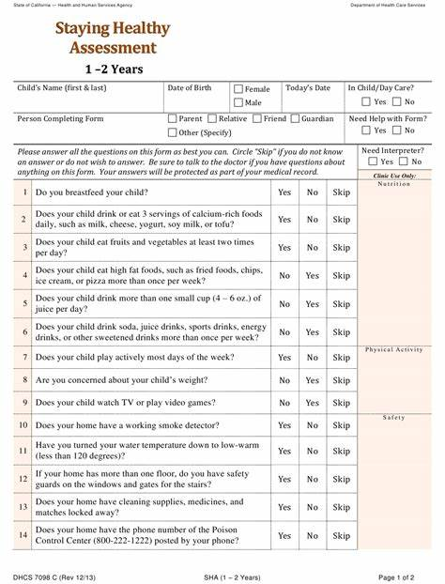
Staying Healthy Assessment (SHA) Form
Staying Healthy Assessment (SHA)
  SHA is the DHCS-sanctioned IHEBA (Individual Health Education Behavioral Assessment) and is a required IHA component:
      Available in 9 age categories and 12 languages
      To be updated annually during well visits and as patient enters a new age group
      Provider must review SHA with patient and provide an intervention for high-risk areas
The Staying Healthy Assessment (SHA) forms must be distributed to new patients during the Initial Health Assessment (IHA) and on a timely basis once patients enter a new age category

Slide 14
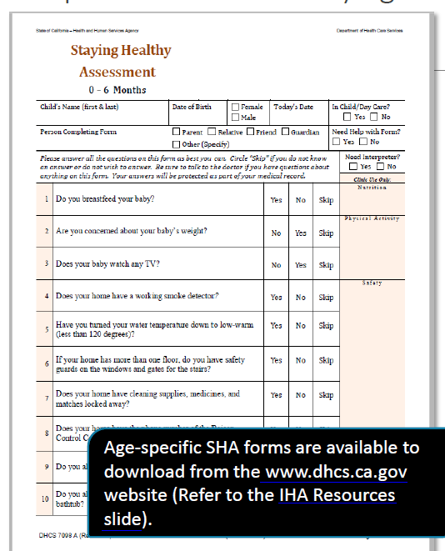
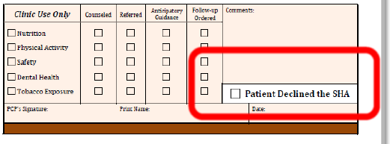
Staying Healthy Assessment (SHA) Form
Include the completed SHA form in the members medical record.
Administer the SHA again when member reaches a new age group.
The adult or senior SHA must be re-administered every 3-5 years, at a minimum and should be reviewed annually.

Slide 15
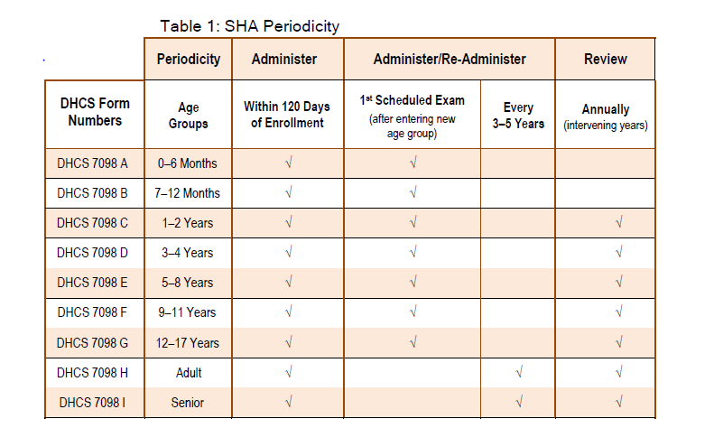
SHA Periodicity
To ensure compliance individuals Must ensure that each member completes a SHA in accordance with the following guidelines and timeframes in Table 1
A member’s refusal to complete the SHA MUST be documented on the appropriate age-specific form and kept in the member’s medical record

Slide 16
SHA Periodicity (Continued)
New Members
New members must complete the SHA within 120 days of the effective date of enrollment as part of the IHA. The effective date of enrollment is the first day of the month following notification by the Medi-Cal Eligibility Data System (MEDS) that a member is eligible to receive services from the MCP.
Current Members
Current members who have not completed an updated SHA must complete it during the next preventive care office visit (e.g. well-baby, well-child, well-woman exam), according to the SHA periodicity table.
Pediatric Members
Members 0–17 years of age must complete the SHA during the first scheduled preventive care office visit upon reaching a new SHA age group. PCPs must review the SHA annually with the patient (parent/guardian or adolescent) in the intervening years before the patient reaches the next age group.
Adolescents (12–17 years) should complete the SHA without parental/guardian assistance beginning at 12 years of age, or at the earliest age possible to increase the likelihood of obtaining accurate responses to sensitive questions. The PCP will determine the most appropriate age, based on discussion with the parent/guardian and the family’s ethnic/cultural background.
Adult and Senior Members
There are no designated age ranges for the adult and senior assessments, although the adult assessment is intended for use by 18- to 55-year-olds. The age at which the PCP should begin administering the senior assessment to a member should be based on the patient’s health and medical status, and not exclusively on the patient’s age.

Slide 17
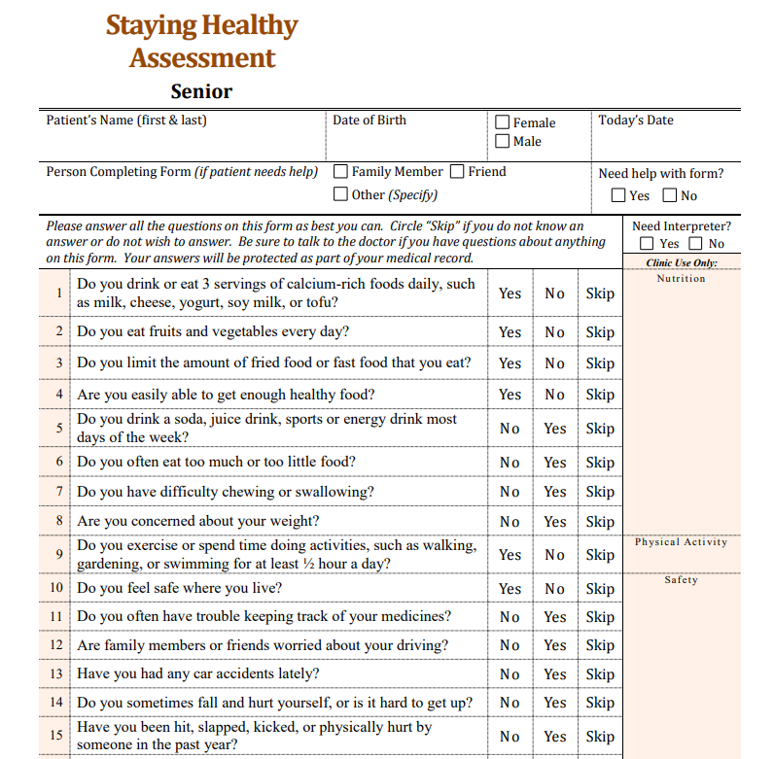
NEW: Staying Healthy Assessment Form for SENIORS
Who should receive the Adult and Senior Assessments?
There are no designated age ranges for the adult and senior assessments, although the adult assessment is intended for use by 18- to 55-year-olds.
The age at which the PCP should begin administering the senior assessment to a member should be based on the patient’s health and medical status, and not exclusively on the patient’s age
You can find access to the most updated SHA forms: Here

Slide 18
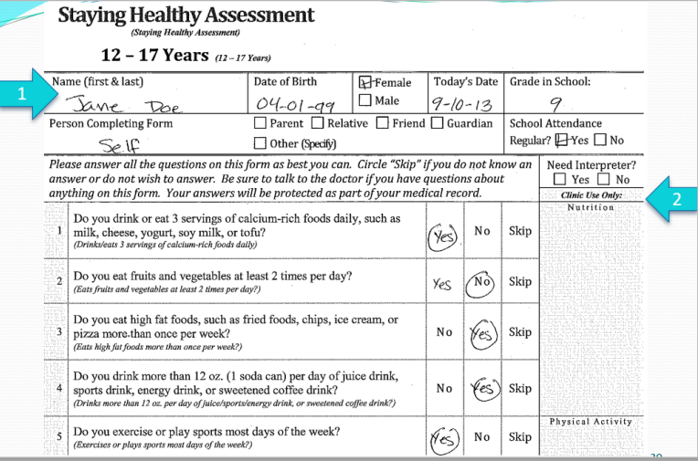
How to submit IHA/SHA documents
To complete the SHA paper form:
Complete form and ensure form includes patient name and PCP signature
Include the completed SHA form in the members medical record.
Input data into COZEVA
To complete the SHA electronically:
Notify your Health Plan at least two (2) months prior to the intended implementation date by completing the Electronic SHA Format Notification Form
Send the completed form to your health plans identified email/fax number.
Input data into COZEVA

Slide 19
Quality Best Practices
The Staying Healthy Assessment (SHA) forms must be distributed to new patients during the Initial Health Assessment (IHA) and on a timely basis once patients enter a new age category.
Pre-Office Visit
Schedule appointment
Mail/Email SHA form to patient prior to appointment
Call patient to remind the individual of their appointment and to bring/send in the SHA form
During-Office Visit
Go over completed SHA form with patient for clarity, and to update patient file
Ask if there are any other health concerns before proceeding
After-Office Visit
Be sure to follow-up on the information you gathered with the SHA by scheduling any necessary labs, screenings, referrals or appointments

Slide 20





Conclusion
Thank you for your continued efforts in providing our members with the highest level of quality care by providing timely access.
MSCHP Quality Management Department MCselectquality@memorialcare.org

